Slide 1
Introduction to PLC Technology
© 2017 John Sefcovic.

Slide 2
Definition
A programmable logic controller is a device capable of storing Instructions and Data for control functions.
Such as, Sequencing, Timing, Counting, Data Handling, and Communications.
It is specifically designed to interface with field devices for Real Time Control of industrial machines and processes.

Slide 3
System Architecture
Rack of Input/Output Modules
Communications Module (Optional)
Processor
Power Supply

Slide 4
System Architecture
A Power Supply provides voltage/current for the internal electronics in the Processor, Communications, and Input/Output Modules.
Power Supply
Note there are some systems where the Power Supply may be used to provide voltage for the devices wired to the Input/Output modules.

Slide 5
System Architecture
The Processor contains the memory and micro-processor for the storage of the data and program files and the interpretation of the data/program logic functions.
Processor

Slide 6
System Architecture
Rack of Input/Output Modules
Input/Output modules are the electrical interface between the processor and the field devices, switches/motors, wired into the modules

Slide 7
System Architecture
Communications Module (Optional)
Many Processors have built-in communication channels or ports, optional Communication module(s) provides for addition network connectivity.

Slide 8
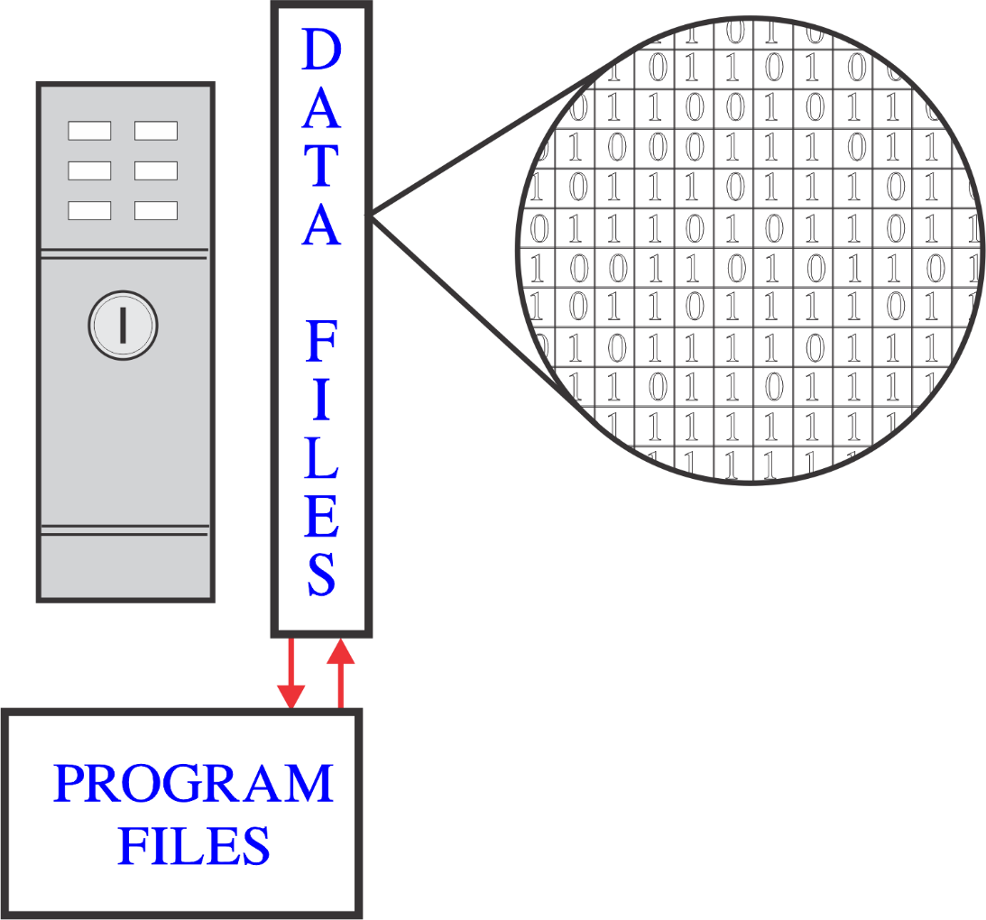
Processor Files
Data files store information in a binary format, 0 or 1.
These digits represent input/output interface states, pre-set values, and other number values.

Slide 9
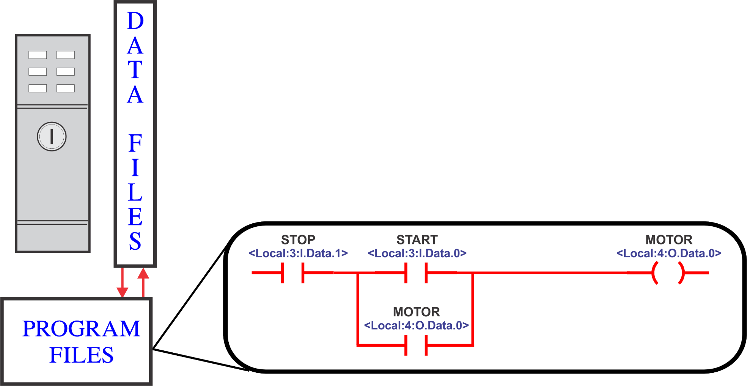
Processor Files
The program files are made up of "rungs" of instructions that are examined to be true based upon what information is in the data files.
A complete path of TRUE Input instructions will cause a TRUE Output action.

Slide 10
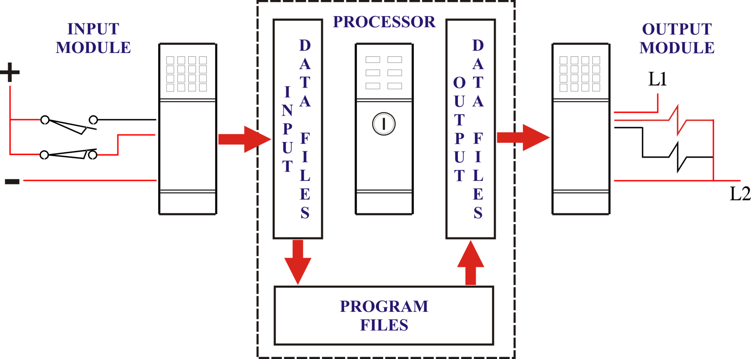
Data Flow
Switches wired into the input module are electrically opened (APART) or closed (MADE).

Slide 11
Data Flow
The Input Module sends the switch status to the processor Input Data File.

Slide 12
Data Flow
Accessing the Data Files, the Program Files solve the program’s Input Logic …
… to turn on or off the
program's Outputs.

Slide 13
Data Flow
The solved output status is stored in the Output Data File.

Slide 14
Data Flow
The Output Data is written to the Output Module to control, turn ON or OFF, the devices wired to the module.

Slide 15
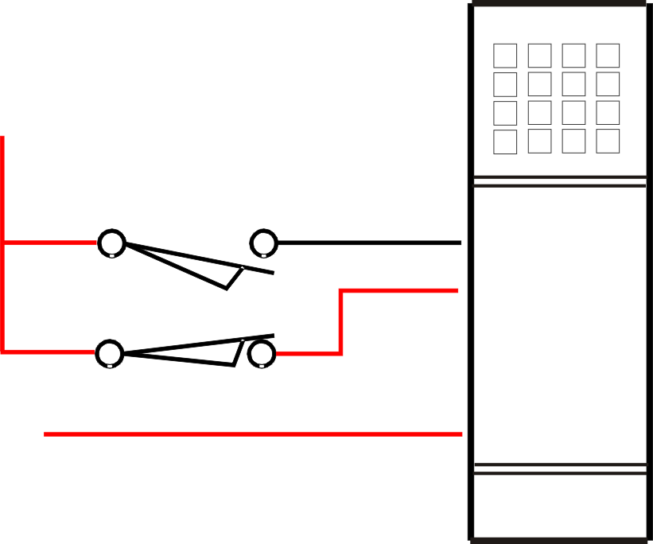
Input Module
The INPUT MODULES tests for the INPUT FIELD DEVICE wired to the module termination to be OPEN (apart) or CLOSED (made).
If the input device is CLOSED (made) for a specified time and designated potential, a LOGIC ONE (or ON) input signal is sent (read) into an address associated with the input termination in the processor’s INPUT DATA FILE.
Else, the input is determined to be OPEN (apart) a LOGIC ZERO (or OFF) signal is sent (read) into the processor’s INPUT DATA FILE.

Slide 16
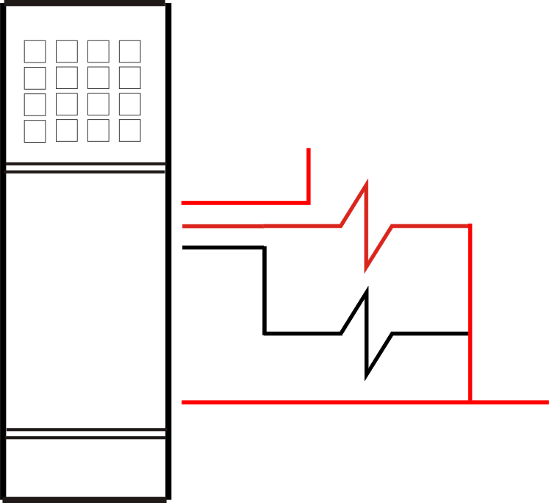
Output Module
The processor solves the logic rung to determine the output state, LOGIC ONE (or ON) or LOGIC ZERO (or OFF) which is stored in the OUTPUT DATA FILE.
In the OUTPUT DATA FILE an output address is associated with the output termination on the module.
The on or off state of the address is sent from the processor OUTPUT DATA FILE to the OUTPUT MODULE, which turns ON or OFF the OUTPUT FIELD DEVICE.

Slide 17
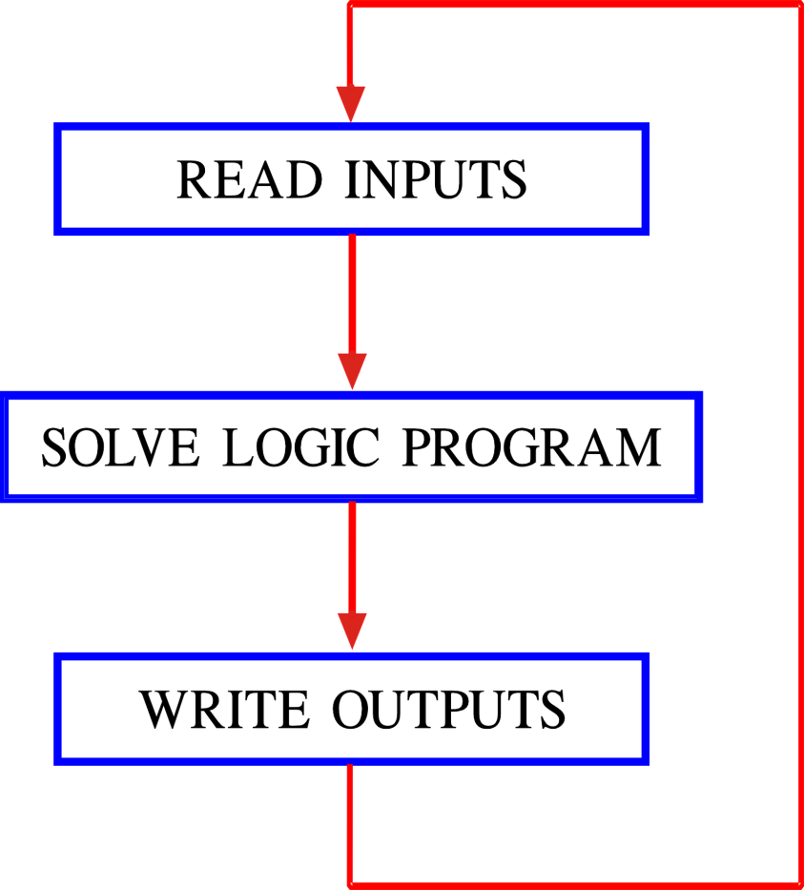
Scan Cycle
The “REAL TIME” control is possible because of the SCAN CYCLE.
By contrast, a “non-real time” linear program run from its start and does not end until all functions have been completed, not considering the time it takes to complete a cycle.
The PLC continuous SCAN CYCLE RUNS MULTIPLE TIMES PER SECOND and responds to input changes to control outputs “almost” instantaneously.

